Slide 1
Biodiversity for the National Parks

Slide 2
Species’s nformation in National Parks
The dataframe, species_info.csv, is composed of 5823 rows
Among the 5541 species, we totalise 7 categories:
Mammal
Bird
Reptile
Amphibian
Fish
Vascular Plant
Non Vascular Plant
It composes by 4 fields: Category, Scientific Name, Common Name & Conservation Status
Scientists defined 5 status :
Endanger,
In Recovery
No Intervention
Species of Concern
Threatened

Slide 3
Are certain types of species more likely to be endangered?
Which type of data?
The research is about species, so data categorical
How many pieces of data are you comparing?
7species
In order to know if there are a signifant difference among them, we process a Chi-Squared Test:
Between the Mammal and Bird, the result is not significant because the p-value equals 0.68
Between the Mammal and Reptile, the result is significant because the p-value equals 0.03

Slide 4
Recommandation
According to the data, some annimal are more in danger than others.
Park Rangers should be more alert with animals such as Mammal and Reptille instead of vasucal plants.

Slide 5
Reduction of Foot & Mouth diseases
During one week scientists anlysed the sheep’s movement in differents parks.The purpose of their research is to reduce, at least, by 5% the foot and mouth diseases of sheep.
Our role is to estimate the size of the sample:
Baseline: 15%
Minimun detectable effect: 33,33%
The sample should contain 870 sheeps
In order to observe enough species, scientists should take:
Yellow Stone, with 507sheeps, will take 1week of observation
Bryce, with 250sheeps, will take 3weeks of observation

Slide 6
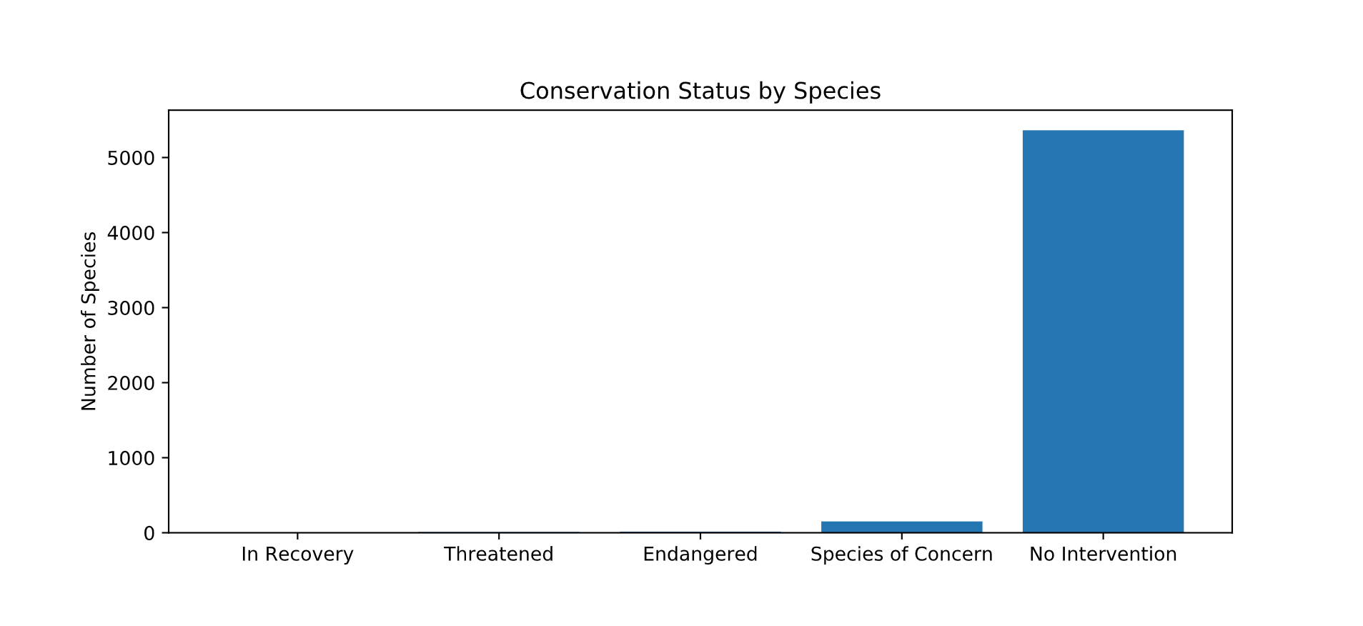
Conservation Status by Species

Slide 7
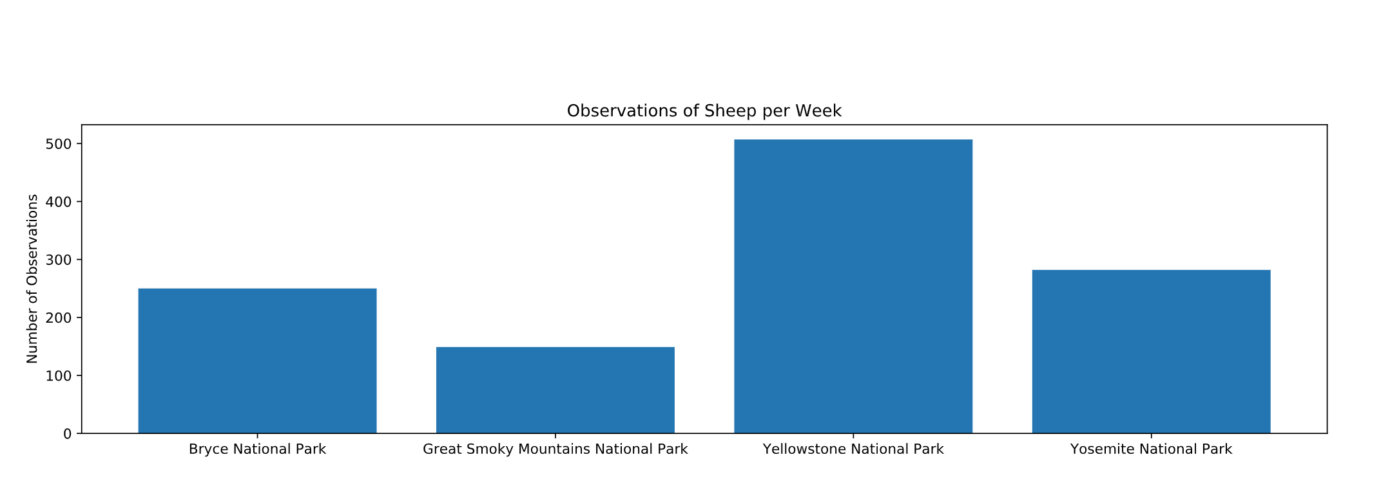
Observations of Sheep per Week

